Slide 1
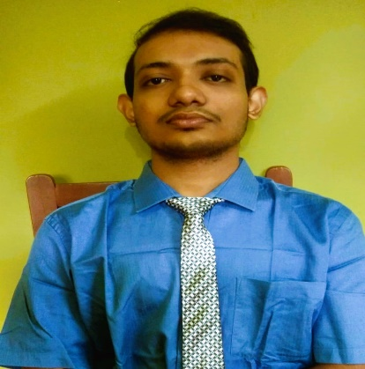






Kunal
Kundu
Full Stack Web Developer,(MERN stack), Software Engineer
CONTACT ME
EDUCATION
B-tech in Computer Science Engineering (on going) – 9.57 CGPA .
Passed X + XI from ISC with 85% aggregate in both.
Made 20+ projects on web development, mobile app dev. Available on github.
West Bengal, Kolkata - 7000145
kunalkundu427@gmail.com
https://www.linkedin.com/in/kunal-kundu-2b4086223/
Passed 10 and 12 from Holy Cross High School .
Currently perusing B-tech in CSE from Netaji Subhash Engineering College.
+91-6291395520
SKILLS
https://github.com/kunal-kundu
HTML
CSS
JavaScript
React JS
Bootstrap
Node.js
Express.js
DBMS – MySQL, MongoDB
OS
Computer Networks
Data Structure and Algorithms
C
C++
Java
Python
https://www.codingninjas.com/codestudio/profile/kunal_e9ca
https://leetcode.com/kunalkundu427/
https://www.hackerrank.com/kunalkundu427
.
Achievements
PROJECTS
1. > Made A full stack project using the latest technologies(MERN stack) in web development. NewsMonkey where one can read the latest news of any country under 7 different categories. More then 500+ news every day. Please try refreshing or navigate to other categories like technology etc, If it takes much time loading. https://voluble-cendol-8256d8.netlify.app
2. > (MERN stack project) MyNoteBook application. Your notes on the cloud. Read and write notes from anywhere anytime and retrieve them from the cloud anytime you need. Don’t worry, your privacy is highly maintained, no one else accept you will be able to read your notes.
https://curious-monstera-c582ea.netlify.app
3.> Made a chrome extension using JavaScript. This Chrome
extension allows you to save as many tabs as you like. And delete
it from your local storage as well.
https://github.com/kunal-kundu/Chrome-Extension/tree/9687a2d69c6ec35704e769dc4ddd7480635c46b0?search=1
4. > Made a famous game Tic-Tac-Toe using HTML, CSS and JAVASCRIPT
https://kunal-kundu.github.io/TicTacToe.github.io/
1.> Three 5* Gold batch in Problem Solving ,Java, C++ in Hacker Rank.
2.> Solved More then 400+ coding questions in LeetCode, CodingNinjas, InterviewBit, HackerRank.
3.> 3* rating for competitive coding in CodeShef.
Work Experience
1.> Intern at persistent University.
https://persistentuniversity.persistent.com/user/profile.php?id=4482

